Slide 1
SMART DISEASE PREDICTOR
PRESENTED BY
SHWETA : SG19CSE133
SUSHMARANI : SG19CSE150
SUSHMAPATIL : SG19CSE147
SHRUTI RAO : SG19CSE132

Slide 2
Table of Contents
03
04
01
05
06
02
IDENTIFYING PROBLEMS
OBJECTIVES
SCOPE
METHODOLOGY
INTRODUCTION
APPLICATIONS
07
RESULTS
ADVANTAGES
DISADVANTAGES
08
CONCLUSION

Slide 3
Introduction
BREAST CANCER :
Breast cancer is cancer that forms in the cells of the breast . After skin cancer, breast cancer is the most common cancer diagnosed in women in the United States. Breast cancer can occur in both men and women, but its far more common in women.
Substantial support for breast cancer awareness and research funding has helped create advances in the diagnosis and treatment of breast cancer.
DIABETES :
Diabetes is a chronic disease that occurs either when the pancreas does not produce enough insulin or when the body cannot effectively use the insulin it produces.
Insulin is a hormone that regulates blood glucose.

Slide 4
HEART DISEASE Heart disease describes a range of conditions that affect the heart. Heart diseases include: * Blood vessel disease, such as coronary artery disease * Irregular heartbeats (arrhythmias) * Heart problems you're born with (congenital heart defects) * Disease of the heart muscle * Heart valve disease Heart disease symptoms caused by irregular heartbeats (heart arrhythmias) The heart may beat too quickly, too slowly or irregularly. Heart arrhythmia symptoms can include: * Chest pain or discomfort * Dizziness

Slide 5
KIDNEY DISEASE
The kidneys are two bean-shaped organs. Each kidney is about the size of a fist. Your kidneys filter extra water and wastes out of your blood and make urine. Kidney disease means your kidneys are damaged and can’t filter blood the way they should.
LIVER DISEASE
The term “liver disease” refers to any of several conditions that can affect and damage your liver. Over time, liver disease can cause cirrhosis (scarring). As more scar tissue replaces healthy liver tissue, the liver can no longer function properly.
Abdominal (belly) pain (especially on the right side).
Bruising easily.
Changes in the color of your urine or stool.
Fatigue.
feel more tired and have less energy
have trouble concentrating
have a poor appetite

Slide 6
IDENTIFYING PROBLEMS
Different diseases prediction with maximum accuracy is a challenging task of the todays doctors. The use of machine learning techniques has increased the accuracy of smart disease prediction systems by exploring the hidden patterns of dataset .
By this project, we are trying to implement functionalities of machine learning in healthcare within a single system. Some cases can occur when an early diagnosis of a disease is not within immediate reach. In such cases, this system can be effectively implemented. So that that it's easier to predict Breast cancer, Diabetes, Heart diseases, Kidney disease, Liver disease
This system will have the capacity to reduce costs of treatment, predict outbreaks of epidemics, avoid preventable diseases and improve the quality of life.

Slide 7
OBJECTIVE AND SCOPE
There are many tools associated with disease prediction which can predict only 1 disease. But generally, there aren't any such tools that are used for the prediction of general diseases. that the
Smart Health Care system helps for the prediction of general diseases like Liver, Kidney, Heart,Breast cancer and Diabetes on one platform. Smart Health Care system is developed using Random Forest and KNN Algorithm etc for predicting the different diseases on a single platform.
Future Scope:
This project will be further developed for the automation of the many different disease predictions more accurately. Also, this project can be made more user-friendly in the future so that everyone can understand the terminologies involved in the project.

Slide 8
METHODOLOGY
DIABETES
In diabetes predictor you have to give number of pregnancy, Glucose level, blood pressure, skin thickness, insulin ,BMI, diabetes Pedigree function, age and submit the form to get the result.
BREAST CANCER
For breast cancer predictor you have to give texture means, compactness mean, concave points mean, symmetry mean, fracture dimension mean , texture standard error, area standard error, smoothness standard error ,compactness standard error, concavity standard error, concave points standard error, symmetry standard error, fracture dimension standard error, texture worst, area worst ,smoothness worst, the compactness worst, concavity worst, concave points worst ,
symmetry worst, fracture dimension worst etc must be given to get the result.

Slide 9
METHODOLOGY
HEART DISEASE.
In heart disease predictor you have to give Age, chest pain type, serum cholesterol ,fasting blood sugar, resting electrocardiography results, exercise induced angina the slope of the peak exercise St segment ,sex, resting blood pressure ,fasting blood pressure ,maximum heart rate achieved ,St depression induced by exercise relative to rest, number of major vessels , Thal.
KIDNEY DISEASE.
In Kidney Disease predictor you have to give age,blood pressure ,spec gravity, albumin sugar ,red blood cells, puss cells, puss cell clumps, bacteria ,blood glucose random, blood urea, serum creatinine, Sodium, Potassium, hemoglobin ,packed cell volume, white blood cell ,counter red blood cell count, hypertension ,Diabetes mellitus ,coronary artery disease ,appetite ,pedal edema, anemia.
LIVER DISEASE
In liver disease predictor by Age, gender, bilirubin, alkaline phosphatase, alamine
aminotransferase, Aspartate Aminotransferase, Albumin, Albumin and globulin ratio.

Slide 10
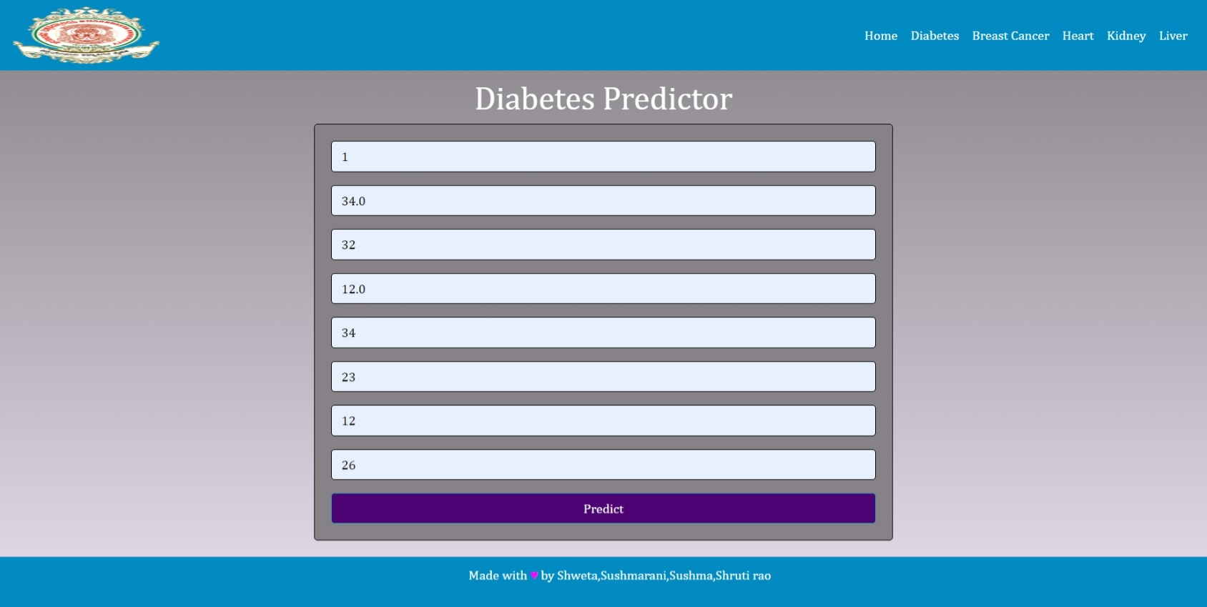
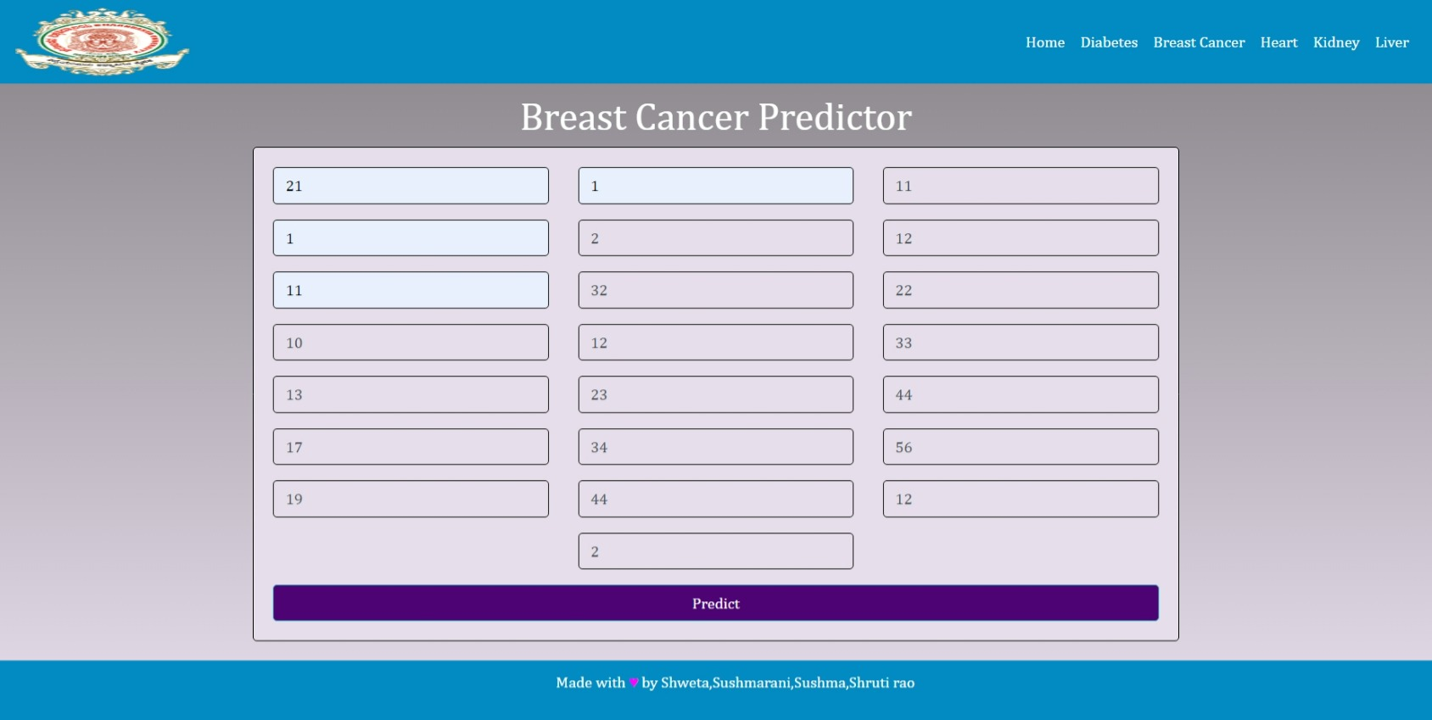
RESULTS

Slide 11
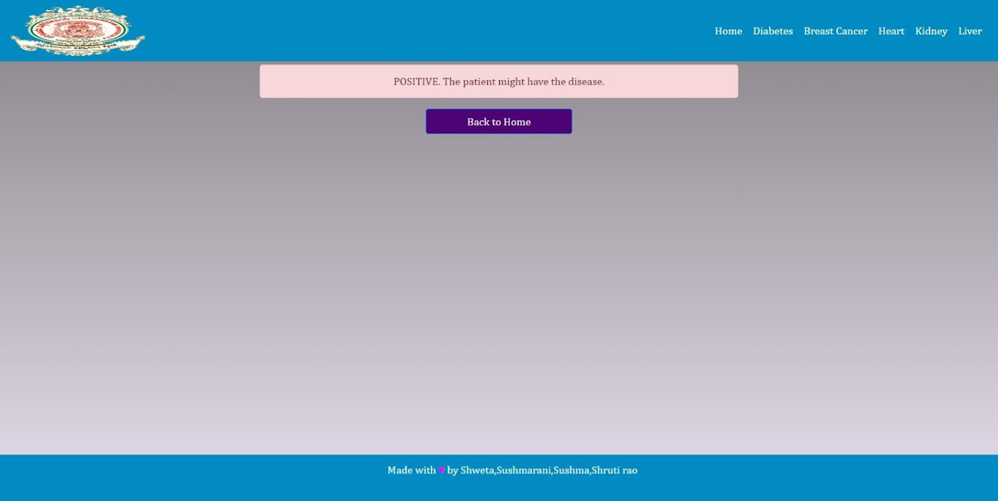

Slide 12
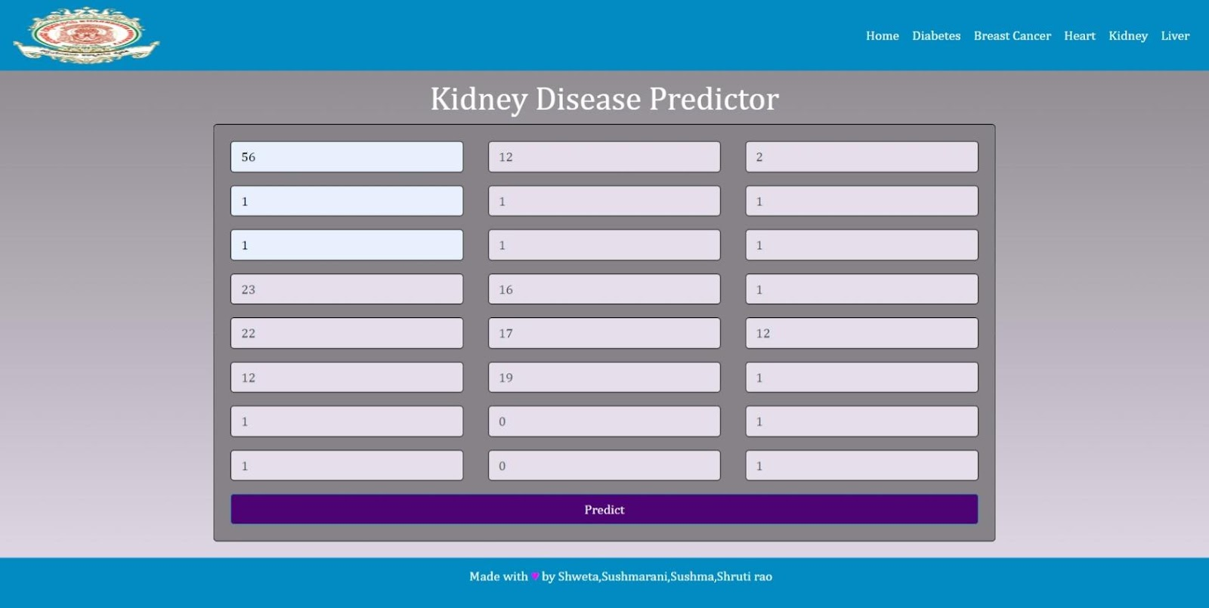
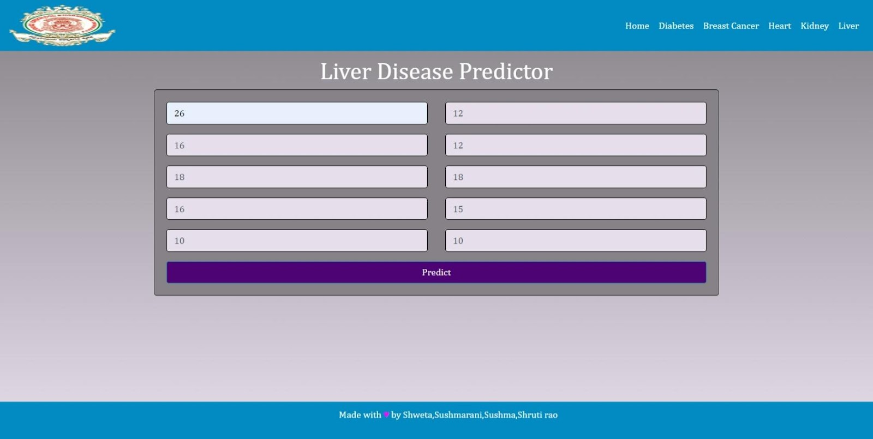

Slide 13
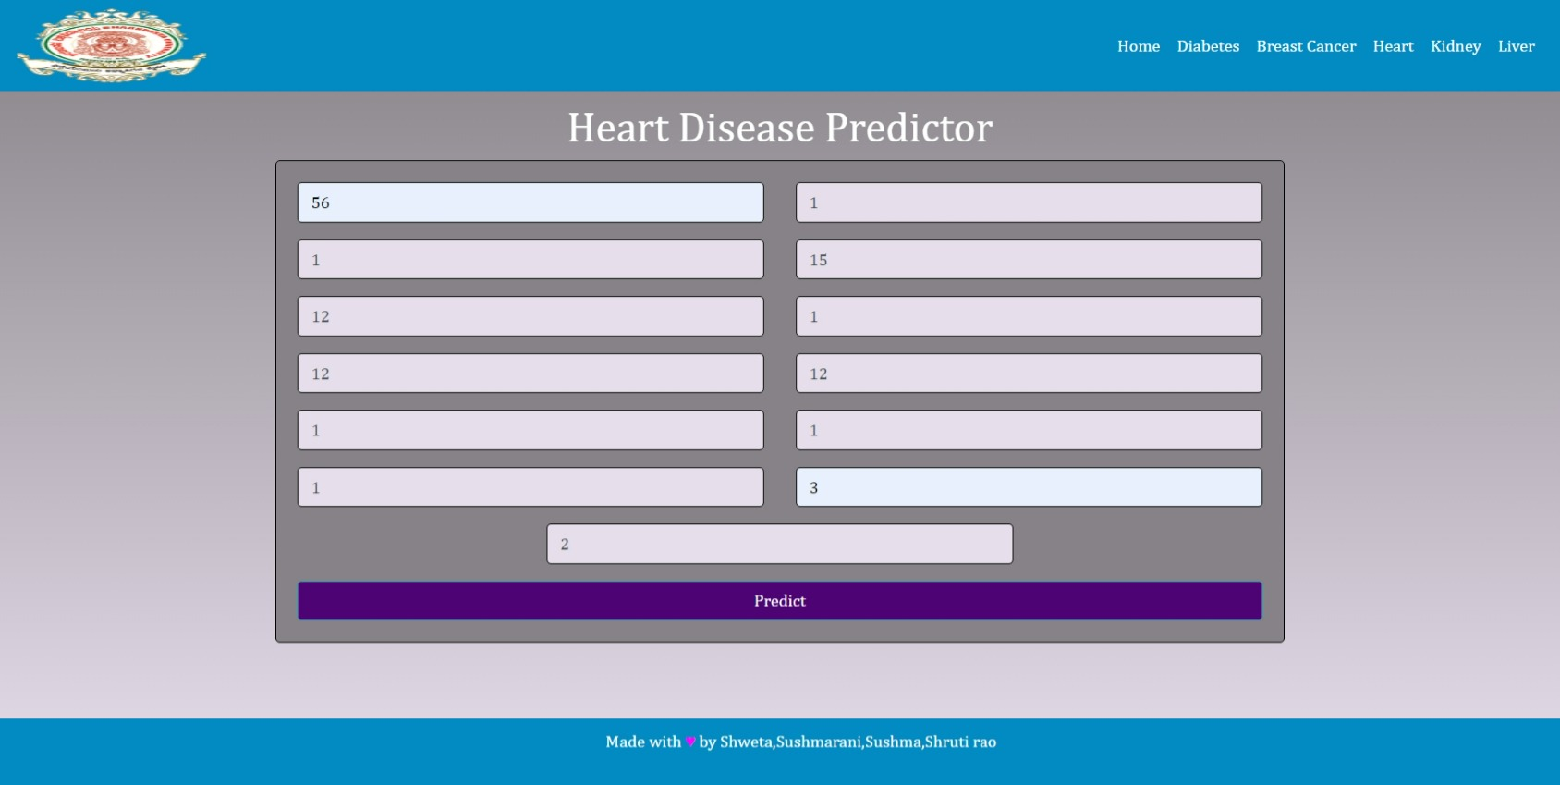
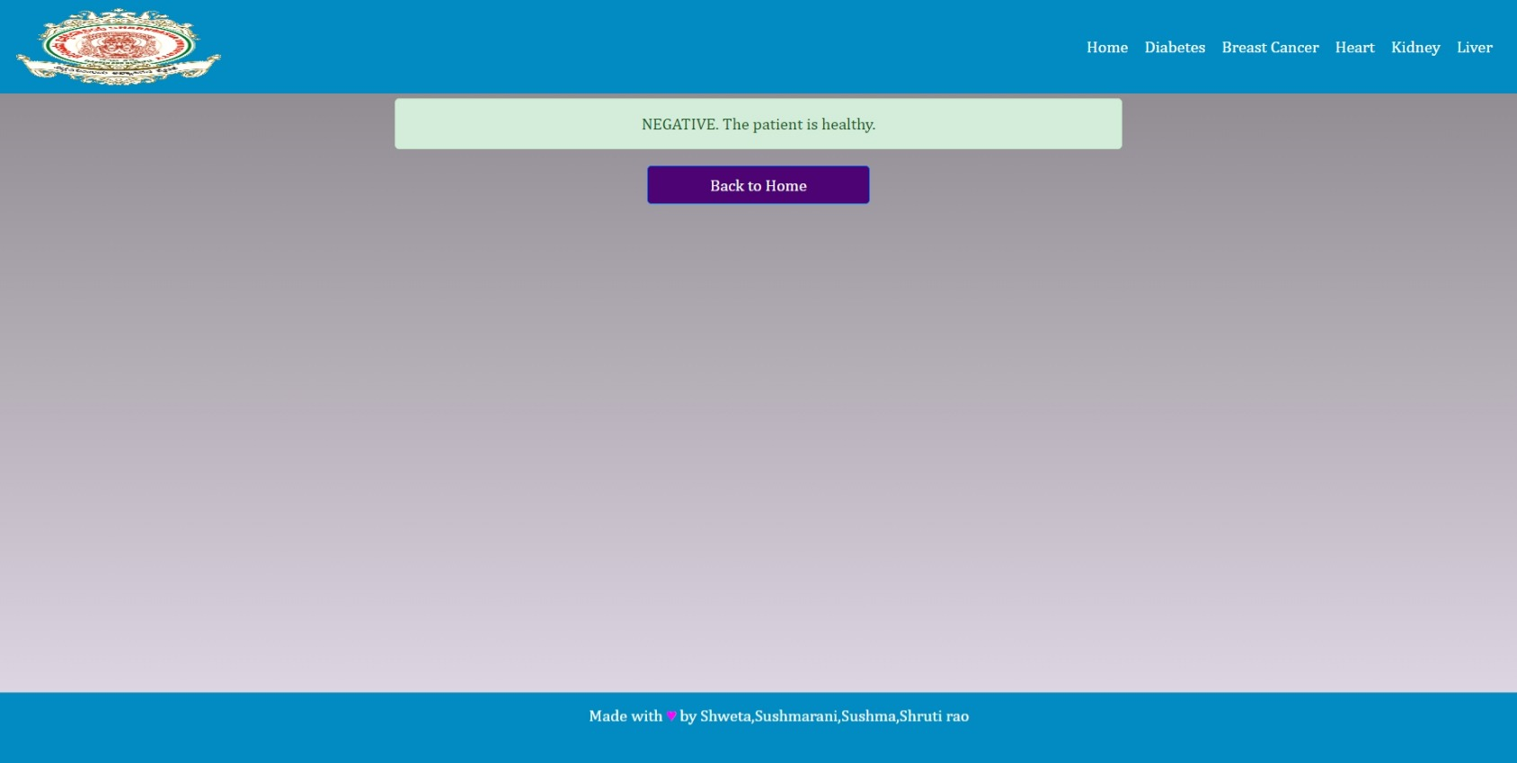

Slide 14
ADVANTAGEs
* Disease prediction has the potential to benefit stakeholders such as the government and health insurance companies. * Can possibly reduce health care costs. * Can be made easily available to everyone * The goal of this comprehensive literature review was to discuss different risk prediction models that have been proposed based on electronic health data. * By entering data, one can know or understand the situation they are in, and if necessary consult a doctor

Slide 15
DISADVANTAGEs
* The system is not fully automated, it needs doctors for full diagnosis. • data ownership problems, privacy and security related issues for human data administration etc. • There are limitations for present AI models such as limited data availability for certain conditions, differences in technology and hardware standards used by different systems across different countries, and so on.

Slide 16
APPLICATIONS
01
03
05
There are various applications of machine learning such as telecommunication industry,
commercial industry, data analysis and many more.
The proposed system can be used in hospitals as health monitoring system.
Through this system, patient can self-assess himself/herself and monitors by self. This is an automatic wireless health monitoring system.
This application will be primarily used for patient data analysis and disease diagnosis at various
levels. There are some patients who require continuous checkups, so this system will be very helpful for them.

Slide 17
CONCLUSION
The main goal of our Project, “ Smart Disease Predictor” is to use Machine Learning for disease prediction and, thus, the competence of ML in improving the diagnosis of disease.
This project aims to predict the disease on the basis of the symptoms provided by the users.
The project is designed in such a way that the system takes symptoms as input from the user through forms and predicts the Disease as output from input.
Based on deep learning techniques the accuracy rating of all five diseases includes:
For Diabetes disease, Heart disease and also for Kidney disease highest accuracy is with the Random Forest Classifier was about 91.67, 0.81 and 1.00. For Liver disease and Breast Cancer , highest accuracy is with the SVM model was about 71.18 97.66

Slide 18

Thank you

